Slide 1
Class 01: Introductions Monday, January 14
INFO 3402: Information Expositions Professor Brian Keegan brian.keegan@colorado.edu

Slide 2
Agenda
11:00 – 11:05: Introductions
11:05 – 11:20: Syllabus overview
11:20– 11:40: Exploratory data analysis
11:40 – 11:50: Using Medium

Slide 3
Introductions
At this stage, most of us have (probably) had a few classes together
Name
Most unexpected thing that happened over break
One thing you’re looking forward to in this class

Slide 4
Learning objectives
Mastering seven fundamental data analysis techniques
Improve confidence in collecting and reshaping data
Identify interesting questions within found data
Use persuasion and storytelling strategies to communicate findings
Think critically about the opportunities and limitations of data
The design of this course is heavily influenced by data journalism courses

Slide 5
Seven fundamental data analysis techniques
Seven two-week modules
Exploring an existing data set
Retrieving new data from the web
Cleaning data into tidier formats
Combining different data sets together
Aggregating data into summaries
Inferring patterns in the data
Extrapolating findings to new data

Slide 6
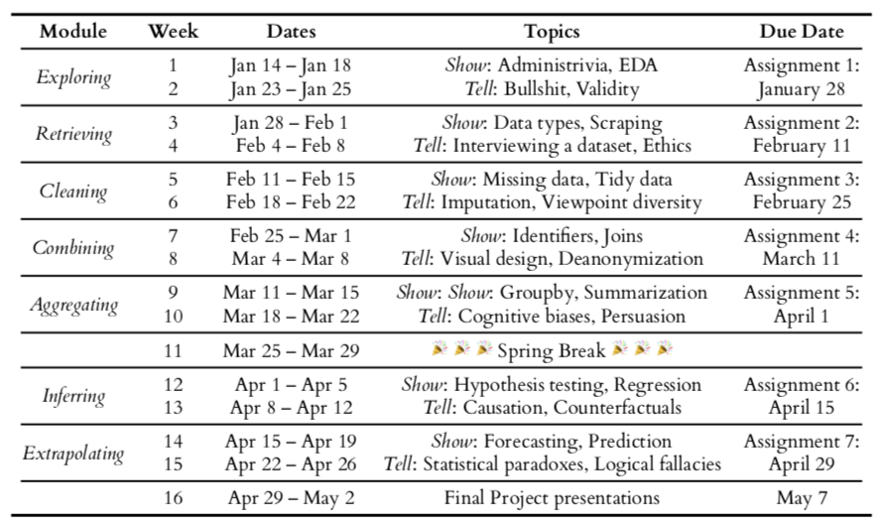
Course overview

Slide 7
Show and tell cycles
The first week of each module will be a “show” week → reviewing a fundamental data analysis technique
Exploratory data analysis, data scraping, missing data, joins, groupby, regression, forecasting
The second week of each module will be a “tell” week → connecting technique to larger social implications
Bullshit & validity, data ethics, imputation, deanonymization, persuasion, counterfactuals, fallacies

Slide 8
Evaluation
Module Assignments (35% of final grade)
5% per Module Assignments x 7 modules
Weekly Presentations (30% of final grade)
2% per week x 15 weeks
Final Project (35% of final grade)
10% for mid-term prorposal
5% for final presentation
20% for final write-up post

Slide 9
What are Module Assignments?
Intended to develop students’ skill and confidence using written communication to share the findings of quantitative data analyses to a general audience
A >750-word write-up posted to class publication on Medium
A “show” module assignment could be a tutorial demonstrating how you applied a technique
A “tell” module assignment could be a report explaining the findings from a data analysis
We will be doing a lot of data analysis and writing in this class
You will be finding new datasets each module, identifying interesting questions, applying new techniques, etc.
Most critically, you will be communicating about these methods and results to a general audience on Medium
Due the Monday after the close of a module at 10:59am as a Medium post

Slide 10
What are Weekly Presentations?
Intended to develop students’ communicating skills by summarizing findings and providing peer feedback
Each Friday students should be prepared to present on their Module Assignment’s progress
Yes, even in the first week of a module → but not this week
Approximately five students will be randomly selected to present their work-in-progress for peer feedback
What is interesting? What is challenging? What are other questions to ask? Alternative data sources or methods?
We will be following the Lerman “Critical Response Process” for structuring feedback
Artist, Responder, and Facilitator roles
Statements of meaning, artist questions, neutral questions, permission opinions → More details next week
Active and good-faith participation as artist and responder to get full credit for each week

Slide 11
What is the Final Project?
The Final Project is a portfolio piece highlighting a student’s analytical and communicative abilities
Most likely (but not required) to be an extension of an existing Module Assignment
More data, deeper analysis, more detailed/polished write-up
Goal is this write-up could be submitted as a guest blog post, op-ed, short research article, etc.
Proposal due around Spring Break will go through Critical Response Process (10% of final grade)
In-class presentations last week of class will also go through Critical Response Process (5% of final grade)
Final written version on Medium due Monday, May 7 (20% of final grade)

Slide 12
Input on designing 3402
What are your goals for INFO 3402? Topics, professionalization, portfolio, etc.
What did you like about INFO 3401 that you would want to continue in INFO 3402?
What are elements of other courses’ designs that should we consider incorporating here?
Notes:
Ben: more powerful conclusions interpretation techniques, grow skills, more technical, more accessible, working with a real stakeholder data
Jacob: believing what I come with, increasing confidence in findings, validity, regression, descriptive/inferential,
Harold: making analysis profitable
Nathan: didn't go very deep in 3401

Slide 13
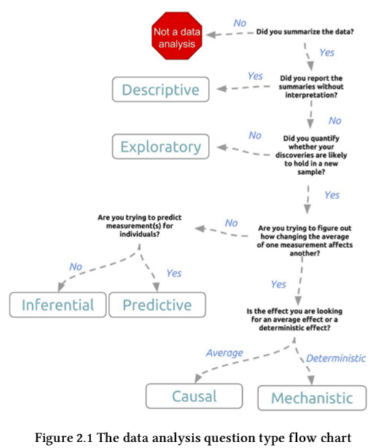
Defining a data analytic question
Descriptive: summarizing measurements without further interpretation
Exploratory: searching for anomalies, trends, or relationships among variables to generate questions and hypotheses
Inferential: quantifying whether an observed pattern in a population will hold with new data
Predictive: testing if some individual-level variables can predict individual-level outcomes
Causal: identifying a clear magnitude and direction of relationship between variables… on average
Mechanistic: changing one variable always and exclusively causes a specific effect. Rare outside of engineering.
Leek (2015) The Elements of Data Analytic Style

Slide 14
Characteristics of a good question
Question should be of interest to audience
Question should not already been answered
Question should be plausible
Question should be answerable
Question should be specific
From Peng & Matsui (2018). The Art of Data Science.

Slide 15
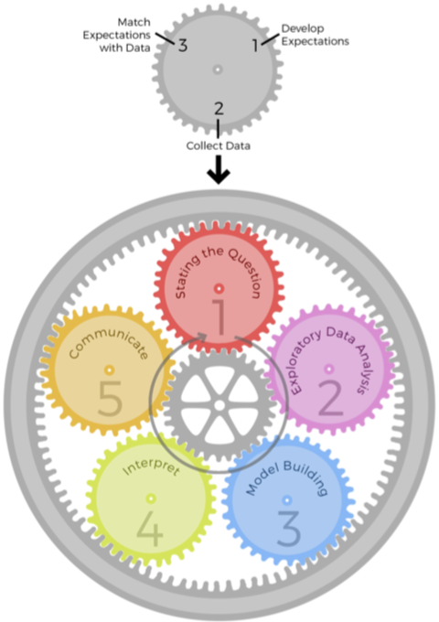
Epicycles of Analysis
Setting expectations
A priori knowledge: what should happen?
Collecting information
Review literature and ask experts about question
Identify and retrieve relevant data
Revising expectations or fixing data to create a match
Compare expectations and data
Update expectations or find alternative data
From Peng & Matsui (2018). The Art of Data Science.

Slide 16
Epicycles of Analysis
 | Set expectations | Collect information | Revise expectations
Question | Question is of interest to audience | Survey literature and experts | Sharpen question
EDA | Data are appropriate for question | Make exploratory plots of data | Refine question or collect more data
Modeling | Primary model answers question | Fit secondary models, sensitivity analyses | Revise model to include other predictors
Interpretation | Specific and meaningful answer to question | Focus on effect sizes, uncertainty | Revise analysis to provide meaningful answers
Communication | Results are understood and meaningful to audience | Seek feedback | Revise analyses of approach to presentation
From Peng & Matsui (2018). The Art of Data Science.

Slide 17
Exploratory data analysis checklist
Formulate your question → see “Characteristics of a good question”
Read in your data → Is it properly formatted? Perform cleanup activities
Check the packaging → Make sure there are the right number of rows & columns, formats, etc.
Look at the top and bottom of data → Confirm that all observations are there
Check the “n”s → Identify “landmark” values and to check expectations (number of states, etc.)
Validate against an external data source → Right order of magnitude, expected distribution, etc.
Make a plot → Checking and creating expectations about the shape of data and appropriate analyses
Try an easy solution → What is the simplest test for your question?
From Peng & Matsui (2018). The Art of Data Science.

Slide 18
Communicating results of an analysis
This is the core goal of this class!
Audience: Who cares about your question and results? Why? Do they share your expertise?
Content: What is appropriate background? What are your objectives? Breadth vs. depth?
Style: Formality of venue? Jargon? When to do discussion?
Attitude: What kind of feedback do you want? What actions do you want audience to take?
From Peng & Matsui (2018). The Art of Data Science.

Slide 19
Using Medium
Blogging platform developed by Evan Williams (Twitter co-founder), launched in 2012
WYSIWYG interface like WordPress, upvoting like Reddit, tags like Instagram/Tumblr
Create account using email, can also be connected with Facebook, Twitter, Google accounts
No need to purchase membership
Your posts will be submitted to the Information Expositions publication
https://medium.com/information-expositions/

Slide 20
Next classes
Wednesday: Finding datasets in the wild, routines using Jupyter for EDA, more Medium if necessary
Come to class with a list of datasets or a new dataset you haven’t used before
Friday: Out-of-town (no Weekly Presentation)
Aaron Jiang (INFO Ph.D. student) will be sharing his work on “Classifying Post-mortem Content on Social Media”
Read paper before Friday, Aaron will share history of challenges with getting this paper published
Readings (for this and next week) → On Canvas
Chapter 2 of Leek, Elements of Data Analytic Style
Chapters 1-4, 10 of Peng & Matsui, The Art of Data Science
Lerman & Borstel, Critical Response Process
Other documentation, tutorials, and resources available on Canvas

